Slide 1
Devaraj S
Final Project
3/21/2024 Annual Review

Slide 2
Emoji Generator using GAN
This project implements a Generative Adversarial Network (GAN) to generate emoji-like images based on text descriptions.
3/21/2024 Annual Review

Slide 3
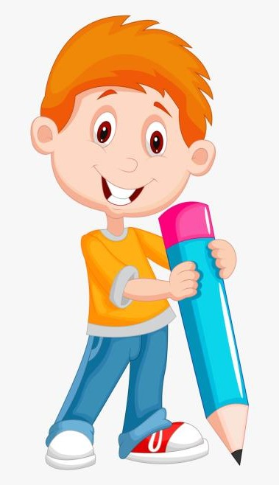

AGENDA
Problem statement
Project Overview
Who are the END users?
Solution
Best part in my solution
Modelling
Results
3/21/2024 Annual Review

Slide 4

PROBLEM STATEMENT
Developing an Emoji Generator using GANs aims to automate diverse emoji creation for digital communication. By leveraging Generative Adversarial Networks, the system generates realistic emoji-like images from noise vectors. The objective is to enrich user experiences by providing a wide range of expressive and culturally relevant emojis. Evaluation metrics assess the diversity, quality, and cultural representation of generated emojis. Improvements involve fine-tuning model architecture and integrating user feedback mechanisms. Ultimately, the project seeks to revolutionize emoji creation, catering to diverse user preferences and enhancing digital communication.
3/21/2024 Annual Review

Slide 5
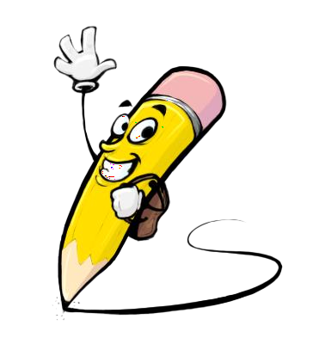
PROJECT OVERVIEW
The Emoji Generator using GANs automates the creation of diverse and realistic emoji-like images for digital communication. Leveraging Generative Adversarial Networks, the system converts noise vectors into expressive emojis. It aims to enhance user experiences by providing culturally relevant and emotionally resonant emojis. Evaluation metrics assess the diversity and quality of generated emojis. Improvements involve fine-tuning the model architecture and incorporating user feedback mechanisms. Ultimately, the project revolutionizes emoji creation, catering to diverse user preferences and advancing digital communication.
3/21/2024 Annual Review

Slide 6

WHO ARE THE END USERS?
The end users of the Emoji Generator using Generative Adversarial Networks (GANs) are individuals who engage in digital communication through messaging platforms, social media, and other online channels. This includes people of all ages and backgrounds who use emojis to express emotions, reactions, and sentiments in text-based conversations. Additionally, digital content creators, app developers, and designers may also utilize the generated emojis to enhance user experiences in their products and services.
3/21/2024 Annual Review

Slide 7

SOLUTION AND ITS VALUE PROPOSITION
The solution involves developing a Generative Adversarial Network (GAN) model trained on a dataset of emoji images. This model generates new emoji-like images based on random noise vectors. The GAN architecture consists of a generator network that creates images from noise and a discriminator network that distinguishes between real and generated images. Through an adversarial training process, the generator learns to produce realistic emojis while the discriminator improves its ability to distinguish real from fake images. The trained model can then be used to generate diverse and culturally relevant emojis for digital communication platforms, enriching user experiences and expanding the range of available emojis. Additionally, the solution includes evaluation metrics to assess the quality and diversity of generated emojis, as well as mechanisms for incorporating user feedback to further improve the model's performance over time.
3/21/2024 Annual Review

Slide 8

THE WOW IN SOLUTION
The "wow" factor in the solution lies in its ability to revolutionize emoji creation and enhance digital communication experiences. By harnessing the power of Generative Adversarial Networks (GANs), the solution automates the generation of diverse, culturally relevant, and emotionally resonant emojis. This not only streamlines the emoji creation process but also expands the range of available emojis beyond what traditional methods can achieve. Users are presented with a rich assortment of expressive emojis that cater to their diverse linguistic and cultural backgrounds, fostering more engaging and authentic interactions in digital communication platforms. Additionally, the solution's iterative improvement process, driven by evaluation metrics and user feedback, ensures continuous enhancement and evolution of the emoji generator, keeping it at the forefront of innovation in digital communication technologies.
3/21/2024 Annual Review
8

Slide 9
MODELLING
The provided GAN model comprises a generator and discriminator.
- The generator uses fully connected layers with ReLU activation to transform random noise into 8x8x1 emoji-like images with tanh activation.
- The discriminator consists of Flatten and Dense layers with ReLU activation to classify real and fake images, using sigmoid activation for binary output.
- The GAN combines the generator and discriminator, freezing the discriminator during training to optimize the generator's ability to produce realistic images.
- Training involves iteratively updating the discriminator and generator to minimize binary cross-entropy loss using the Adam optimizer.
- The training loop iterates through the dataset, generating fake images and updating the discriminator to distinguish real from fake.
- Finally, the generator is updated to enhance its ability to generate convincing emoji-like images, resulting in a basic yet functional emoji generator model.
3/21/2024 Annual Review
9

Slide 10
RESULTS
The result of training the GAN model is a generator capable of producing diverse emoji-like images from random noise vectors. Through adversarial training, the generator learns to create realistic emojis while the discriminator distinguishes between real and generated images. The quality and diversity of the generated emojis depend on factors such as dataset quality and model architecture. Continuous refinement and evaluation are crucial to improve the realism and diversity of the generated emojis. Ultimately, the trained model enhances digital communication by providing a wide range of expressive and culturally relevant emojis.
10

